Slide 1

CZ4041 Machine learning
Group 26
Bryan Lim Yi Yong
Fang Wen Jie
Francisco John Radcliff Pantaleon
Koh Yao Wei Anthony

Slide 2
Outline
Introduction
Kaggle Evaluation Score and Rank
Methodology
Model Experiment
Challenges Faced
Conclusion

Slide 3
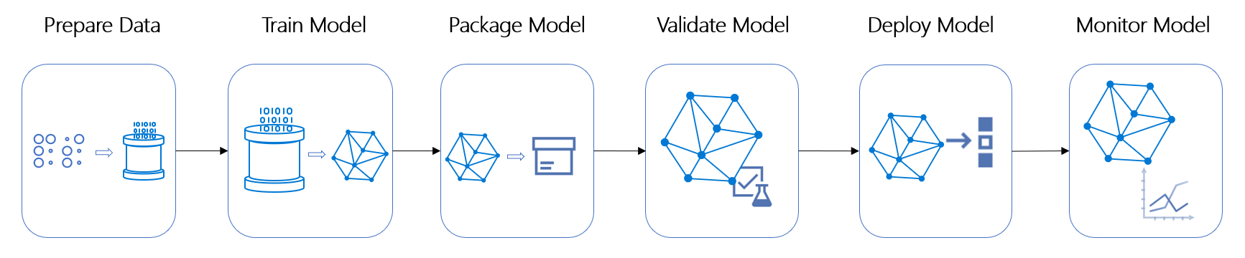
Introduction
Kaggle Challenge: Cat in the Dat challenge
In Machine Learning
Notes:
This Categorical Feature Encoding Challenge where we are required to encode the different features and pass the encoded features into machine learning algorithm and see how they perform

Slide 4
Ranking

Slide 5
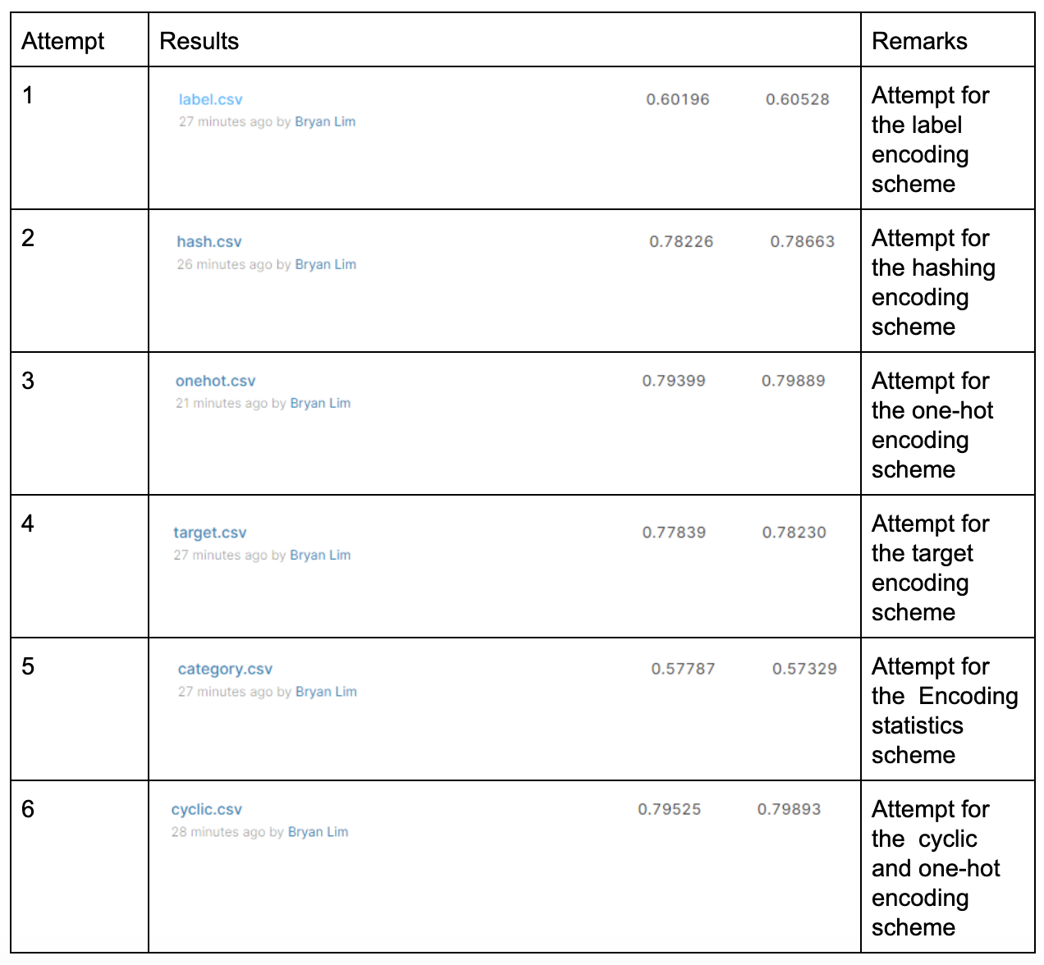
Kaggle Ranking

Slide 6
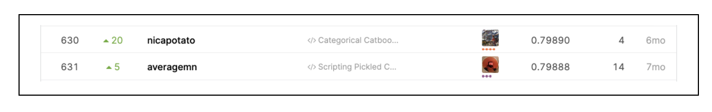
Kaggle Ranking
Private leader board

Slide 7
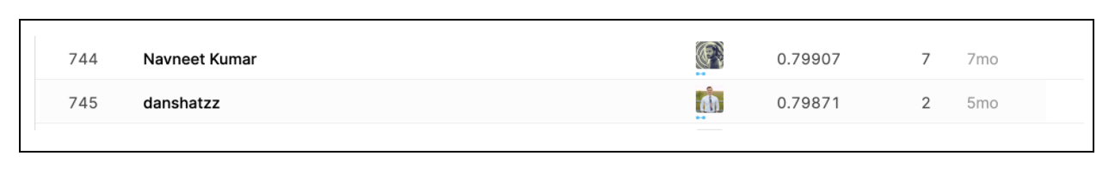
Kaggle Ranking
Public Leaderboard

Slide 8
Encoding methods

Slide 9
One-hot encoding
Creates one new column for each unique features
Row in new column marked 1 if contain the column’s value
Row in new column marked 0 if does not contain the column’s value
Can lead to serious memory problem
Curse of dimensionality
Notes:
The one-hot encoder creates one new column for each unique value in the column for comparison. The row in the new column is marked as 1 if it contains the column’s value and 0 if it does not. Even though one-hot encoding can perform very well in classification tasks, it can lead to serious memory problems if the dataset has high cardinality features. It can also lead to a curse of dimensionality which results in overfitting.

Slide 10

One-hot encoding

Slide 11
Label Encoding
Each unique non numerical values in each column is converted into model-understandable numerical data.
Model might think that data are in some of sort of order
0 < 1 < 2 < … < N
Notes:
In label encoding, each unique non numerical values in each column is converted into model-understandable numerical data.
However, there exists a problem with label encoding for categorical data where the model might think that the data are in some kind of order, 0 < 1 < 2 …. < N, which is not the case in this dataset.

Slide 12

Label Encoding

Slide 13
Feature Hashing
Similar to one-hot encoder
Converts categorical variable to a higher dimension space of integers
Advantageous when cardinality of feature is very high
Eg: ‘nom_9’, 11981 unique values
May result in data lost due to collision
Notes:
Hashing is similar to one-hot encoder but with new dimensions. Hashing converts the categorical variables to a higher dimensional space of integers. Hashing is advantageous when the cardinality of features is very high, in our case, ‘nom_9’. However, hashing can encounter problems such as collision which results in data lost.

Slide 14

Feature Hashing

Slide 15
Target Encoding
Similar to label encoding
Labels directly related to target
Feature label decided with mean of target variable
Brings out the relation between similar categories
Does not affect volume of data, allows faster learning
Prone to overfitting
Notes:
Target encoding is similar to label encoding. But in target encoding, the labels are directly related with the target. For example, the feature label is decided with the mean value of the target variable on training data which brings out the relation between similar categories.
Target encoding does not affect the volume of data and allows faster learning. However, one of it’s many caveats is overfitting

Slide 16

Target Encoding

Slide 17

Encoding Statistic

Slide 18
Encoding Statistic

Slide 19
Models

Slide 20
Logistic Regression
Statistical technique
Predicted variable is binary
true/false
pass/fail
yes/no
win/lose
Notes:
Logistic regression is a statistical technique used to model the relationships between the predictors and the predicted variables where the predicted variable is binary such as pass/fail, win/lose, yes/no, true/false.

Slide 21
Logistic Regression
Private Score | 0.79399
Public Score | 0.79889

Slide 22
XGBoost
Implementation of gradient boosted decision tree
Adaptively changes distribution of training data
Focusing more on previously misclassified records
Notes:
XGBoost is an implementation of gradient boosted decision trees designed for speed and performance where it adaptively changes the distribution of training data by focusing more on previously misclassified records.

Slide 23
XGBoost
Private Score | 0.69303
Public Score | 0.68805
Notes:
0.69303
0.68805

Slide 24
Random Forest
Ensemble learning method
Construct multitude of decision tree
Output class is the mode for classification, mean for regression
Notes:
Random forests or random decision forests are an ensemble learning method for classification, regression and other tasks that operate by constructing a multitude of decision trees at training time and outputting the class that is the mode of the classes for classification or mean prediction for regression of the individual trees.

Slide 25
Random Forest
Private Score | 0.62279
Public Score | 0.62047
Notes:
0.62279
0.62047

Slide 26
Challenges Faced

Slide 27
Challenges Faced
Understanding how the different encoding method works
One-hot encoding
Hashing
Cyclic encoding
Target encoding
Label encoding
Notes:
Some of the challenges that we faced includes finding out which encoding method works best for the different categorical data, understanding how the different encoding method works.

Slide 28
Challenges Faced
Combining various encoded features
Hashing the features separately and then combining them
Merging one-hot and cyclic
Solution
Merging cyclic encoding with one-hot encoding
One-hot for bin, nom, ord features
Cyclic for cyclical features
Notes:
However, the biggest hurdle was trying to combine the various encoded features before training to further improve our results. Since the dataset contains categorical features such as day and month which belong to the cyclical category, one-hot encoding is not exactly viable as one-hot encoding is only suitable for nominal or ordinal data. As such, we would have to use cyclic encoding for cyclical data.
Hoping that by hashing the different data types separately can improve the performance of our model, we decided to hash the ordinal data, nominal data and cyclic data separately. However, little did we know that hashing actually tries out all the possible different combinations and by merging the 3 different hashed data, we will end up with 3 times the amount of extra columns as compared to just hashing the whole dataset itself. The results of the merged dataset performs a lot worse than just hashing the dataset itself. We attribute this to overfitting since the dimension of the data is increased. We also tried to resolve the problem of having extra columns. But despite weeks of effort in trying to resolve it, we were unable to come up with a solution.
Hence, we decided to just go ahead with combinen one-hot and cyclic encoding where one-hot encoding is used for the binary, nominal and ordinal features, cyclic encoding for cyclical features.

Slide 29
Conclusion

Slide 30
Conclusion
Cat-in-Dat
Achieved close to 79% accuracy
Proposed using one-hot encoding and cyclic encoding
Logistic Regression model
Key takeaways
Different encoding techniques
Importance of the proper encoding of data
Parameters fine tuning
Notes:
Firstly, this project has exposed us to the different encoding techniques that were otherwise not being taught on paper. It was also found out that by combining various encoding schemes allows us to achieve better results.
Secondly, this project has also exposed us to the importance of the proper encoding of our data. This is especially so for categorical data where the data are not in some kind of order and by using improper encoding methods, our model might think the data are in some kind of order, 0 < 1 < 2 …. < N. This is shown in section 5.2.
Lastly, we have also learnt that parameters fine tuning is very important in leveraging the full potential of the model to achieve outstanding results.
Overall, this project has largely improved our knowledge on machine learning and has been very enriching and interesting on how the different encoding methods can affect the final predictive results.

